Slide 1
Risk Management - Liquor Liability - D&O
presents
Presented by:
Marcel Arsenault, CIP

Slide 2
AGENDA
Risk Management
Liquor Liability
Directors and Officers (D&O)
Miscellaneous Common Exposures

Slide 3
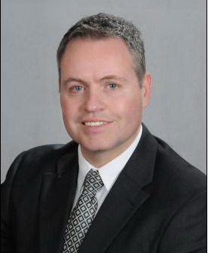
Presenter – Marcel Arsenault, CIP
Marcel Arsenault has worked in the insurance industry for 20 years. After attending the Insurance Program at Mohawk College, in Hamilton, ON, Marcel began his career as an independent adjuster. He spent the majority of his adjusting career with Cunningham Lindsey Canada and Crawford Adjusters in ON, AB, PE, and NB. Marcel handled automobile, home, general liability, and commercial losses. Marcel also spent several years on Crawford & Company’s Global Catastrophe Team where he handled hurricane, flood and ice storm claims throughout Canada and USA.
Marcel took on the role of commercial broker with Hyndman & Company Limited in 2013. He obtained his Chartered Insurance Professional (CIP) designation in 2015. In 2016, he migrated to Cooke Insurance Group as a commercial broker.

Slide 4
Cooke Insurance Group is one of Atlantic Canada's leading insurance brokerage companies. Founded in 1972 and with 10 offices throughout the Maritimes, our goal is to meet and surpass all your insurance needs. We take the time to work with you to help protect what matters most to you.

Slide 5
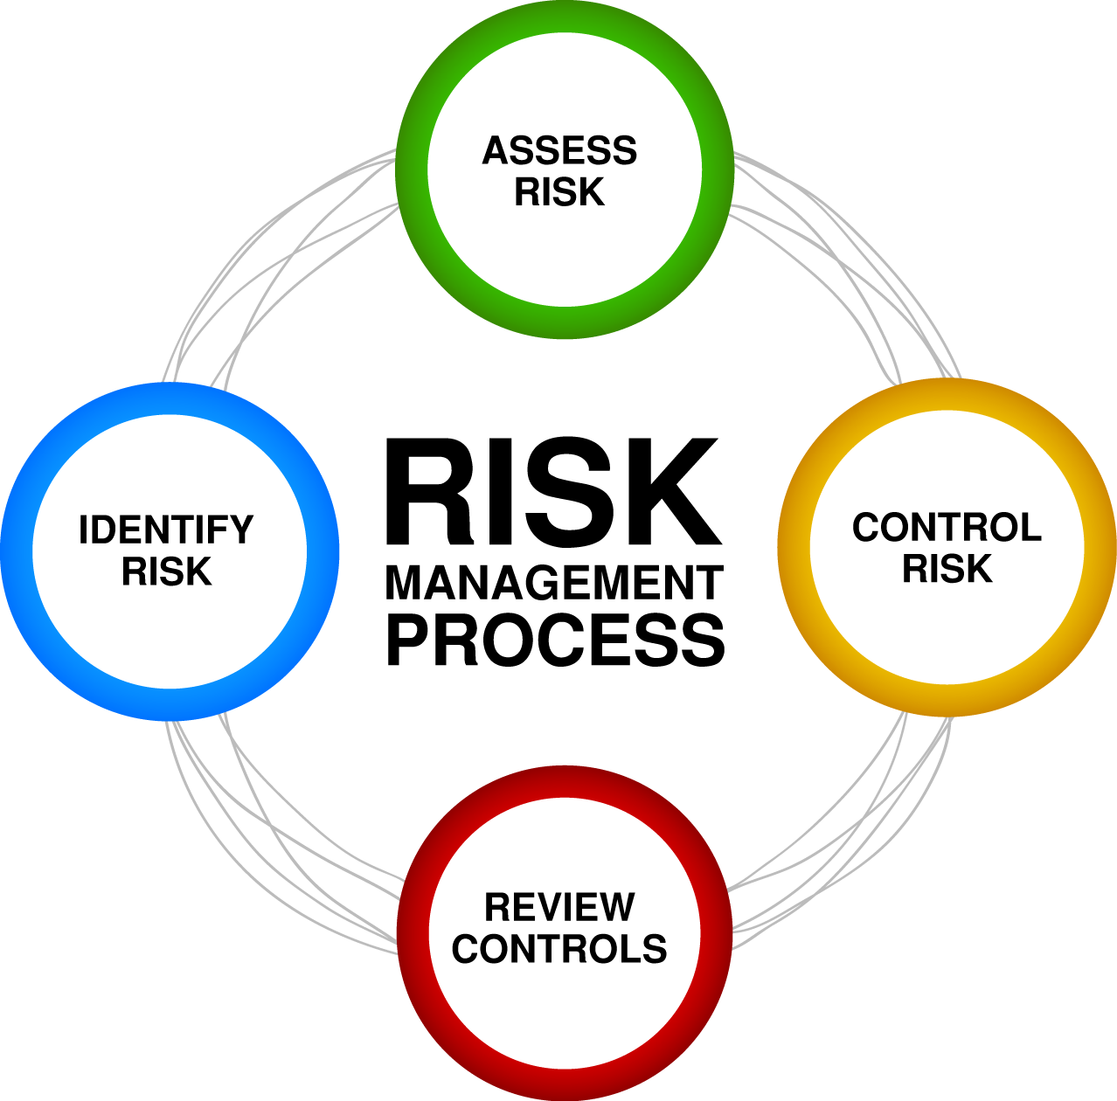
risk management

Slide 6
Defining risk management
Risk Management refers to the practice of identifying potential risks in advance, analyzing them, and taking precautionary steps to reduce/curb the risk.

Slide 7
Benefits of a risk management plan
How does risk management impact your bottom line?
Opportunity for better pricing on insurance premiums
Saves out-of-pocket costs like deductibles
Ensures a safe and stable environment for employees, volunteers and customers
Helps you understand and be prepared for risks before losses occur

Slide 8
Mitigate & prevent risk
Risk Avoidance: Can you eliminate a service or activity considered too risky?
Eliminate activities that involve risk
Avoid creating activities that involve risk
Mitigation or Prevention: What steps can be taken to reduce the severity of losses if they occur?
Manage liability by structuring activities and programs in ways that reduce or limit institutional risk
Risk Transfer: Can we transfer the risk and/or financial consequences of a loss to another party?
Insurance policies
Indemnification agreements
Releases and waivers
Risk Retention: Accept the risk as it is—some risk is inherent in the activities of the operation.
Self-insurance
Deductibles
Deciding not to insure a specific exposure

Slide 9
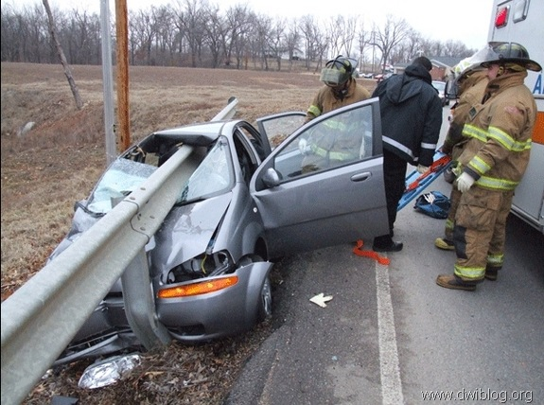
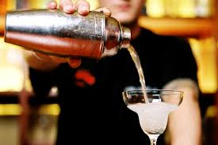
liquor liability

Slide 10
liquor liability – are you exposed?
Any establishment that sells, serves, or assists in the purchase or use of liquor opens its doors for a liability claim as a consequence of someone getting drunk to the extent that injuries or property damages are the result.
Liquor liability exposures can be insured under general liability policies. If you serve liquor then you should ask your broker whether you have this coverage as it is not automatically included on all policies.
Limits of insurance coverage and amount of premium vary by the operations being insured.
Coverages are subject to policy terms, conditions, and exclusions.

Slide 11
liquor liability – statistical fodder
More than 50 per cent of first-time drunk-driving offenders were being served at a licensed restaurant or bar before getting into their cars and endangering the lives of others. Not only were these people liable for their actions, the establishments where they were drinking were also susceptible to punishment for over-serving clientele who then injure a third party.
Victims and their families file suits against restaurants or bars every day for their role in serving a customer who is then involved in an alcohol-related accident. To help protect your establishment, employees and patrons, establishing an events and liquor liability prevention policy, training workers and transferring risk are critical to minimizing your events and liquor liability

Slide 12
Managing liquor liability exposure
It is imperative that you design an events and liquor liability training program for staff members who will serve alcoholic beverages to customers.
In these training sessions, employees will learn important information such as how to determine if someone has had too much to drink, how to deny service to a patron and how to identify valid forms of identification to prevent serving alcohol to minors.
Once an employee has completed the training, he or she should sign an agreement form outlining that they comply with and understand the policies set forth by the establishment.

Slide 13
Managing liquor liability exposure
Staff Training should include the following:
Identifying Signs of Intoxication
Monitoring Consumption
Offering Continued Service (ie: suggest or sell food items and slow down the service while engaging in conversation.)
Denying Service -Establish a policy for how to deny patrons service when they have had too much to drink.
Reporting Incidents - After an incident has occurred, it is necessary that employees fill out an incident report. This helps to reduce your liability

Slide 14
liquor liability - Employee Legal Consequences
Criminal Liability: Employees can be found criminally liable for serving to minors with a fake ID or serving to a patron who appears intoxicated. The employee can face monetary fines, probation or jail time depending on applicable laws. In addition, your establishment can lose its liquor license and is susceptible to fines as well as higher insurance premiums.
Civil Liability: If employees are found guilty of civil liability for a patron’s injury, that employee, the owner and the establishment face large monetary fines.

Slide 15
Directors & officers

Slide 16
Directors & officers
Directors and officers have a duty to exercise due diligence in overseeing the management of the organization that they serve. This involves 3 basic duties:
Duty of Diligence (Duty of Care): Act reasonably, in good faith and in the organization’s best interest.
Duty of Loyalty: Place the interest of the organization before your own.
Duty of Obedience: Act within the scope of applicable bylaws.

Slide 17
Directors & officers insurance
Unlike a Commercial General Liability policy that provides coverage for claims arising from property damage and bodily injury, a D&O policy specifically provides coverage for a "wrongful act,” such as an actual or alleged error, omission, misleading statement, neglect or breach of duty.
If you have a D&O exposure, ask your broker if you are covered as it is not considered part of your regular Commercial General Liability policy .
Limits of insurance coverage and amount of premium vary by the directors and officers’ duties.
Coverages are subject to policy terms, conditions, and exclusions.

Slide 18
Directors & officers – Liability Exposures
In addition to basic duties, a director or officer may be held liable for:
Failure to act as stated under a statute. ie: If a statute requires directors to file a report or maintain certain records, and these reports or records are not maintained, the director may be liable for an offence by statute.
Non-compliance of the organization with a statute. ie: directors may be liable for financial losses, wrongful dismissal, employee discrimination or failure to remediate environmental damage. Be aware that directors can be held personally liable and that: (1) ​​Ignorance is not a defence. (2) Resignation is not necessarily a defence. (3) Company indemnity may not be enough.

Slide 19
Directors & officers - Coverages
A D&O policy provides defence costs and indemnity coverage to the entity listed on the policy declarations, which may include:
Coverage for individual directors and officers;
Reimbursement to the organization for a contractual obligation to indemnify directors and officers that serve on the board; and
Protection for the organization or entity itself.

Slide 20
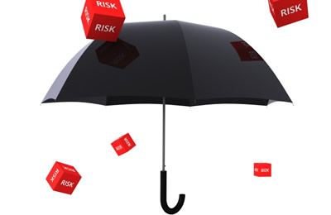
Other liability exposures

Slide 21
Other liability exposures
While every business and non profit is unique in its own way, there are universal exposures that many of them face. In addition to insuring your specific risks, you need to consider coverage that will protect you from common exposures generated by everyday operations. The next slide will mention a few, but not all, exposures you face. We will not address them in this presentation, but you should speak with your insurance broker to see whether you have these exposures and whether you have the proper coverage in place to protect your organization and yourself. You are invited to request more information from Cooke Insurance Group whether you are currently a client or not.

Slide 22
Other exposures
Employment Practices Liability: Covers losses resulting from employment practices disputes, such as claims filed for discrimination, sexual harassment and wrongful termination.
Fiduciary Liability: Covers losses resulting from mismanagement of employee benefit and pension plans.
Crime Insurance: Covers losses resulting from employee or outsider criminal activity such as theft, fraud, Dishonesty, Disappearance and Destruction and employee dishonesty

Slide 23
Contact information
Marcel Arsenault, CIP Commercial Business Broker
Tel: 1-800-566-5666 Ext 4814 Fax: 1-855-566-4662 Cooke Insurance marsenault@cooke.ca
http://www.cooke.ca/

